Slide 1

S.C.A.M
Secure Cryptocurrency Asset Management Platform
BY
GROUP NUMBER 18
ARCHIT SINGH ( 002813253 ) AMIT KANOJIA (002208440 )
DEPARTMENT OF COLLEGE OF ENGINEERING
NORTHEASTERN UNIVERSITY
BOSTON, MASSACHUSETTS – 022115
DECEMBER 2023

Slide 2
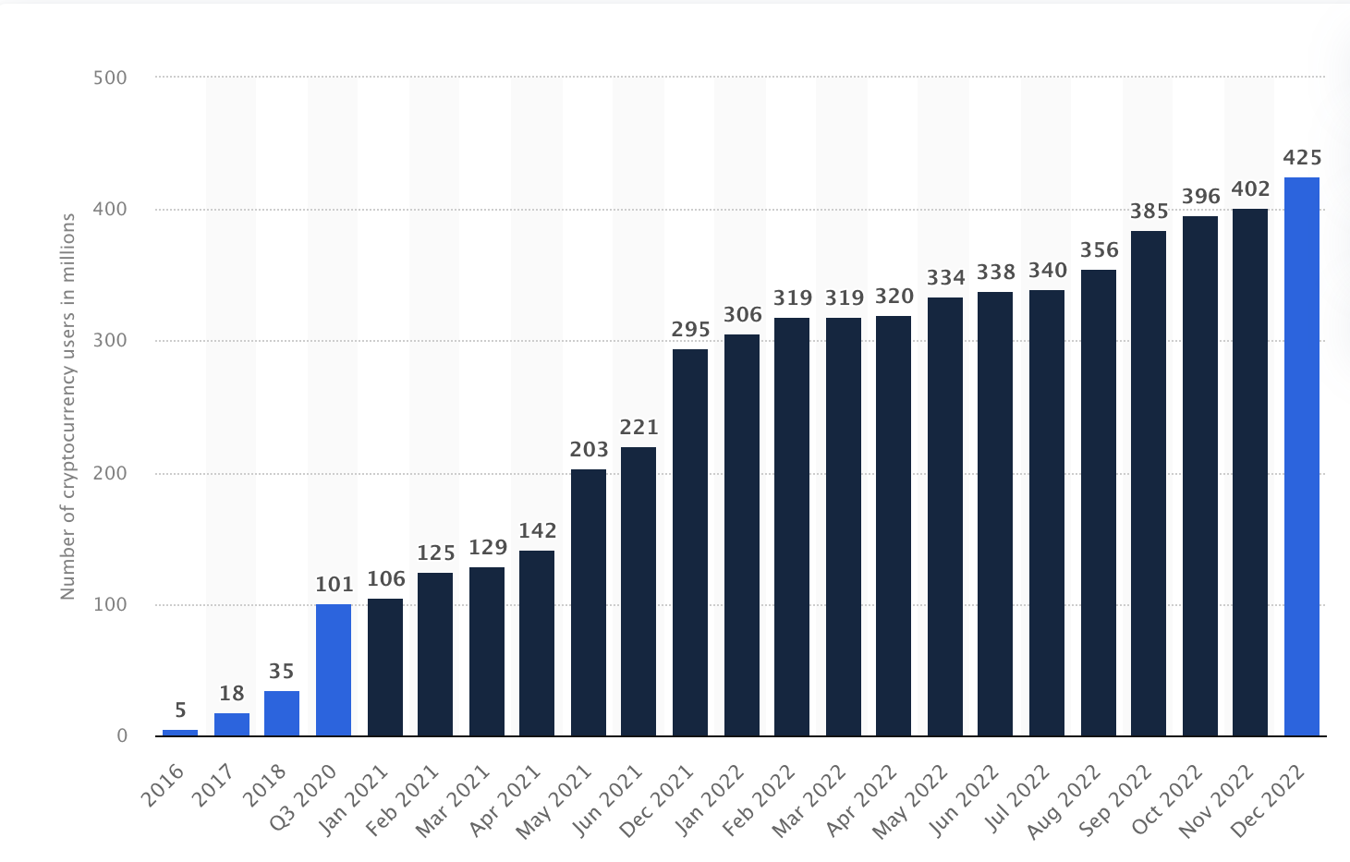
INTRODUCTION & BUSINESS PROBLEM
A cryptocurrency is a digital or virtual currency secured by cryptography, which makes it nearly impossible to counterfeit or double-spend. The popularity of cryptocurrencies continues to grow at a rate of 8000%, equaling $1.4 Trillion Dollar in the global cryptocurrency market cap.
While traditional forms of investment offer predictable risks, low volatility, and stable returns, the potential returns from cryptocurrency investments far exceed those of stocks, bonds, and real estate. However, it is important not to overlook the risks associated with cryptocurrencies, such as :
Data Security
High Volatility
Technical complexity
General lack of understanding of the financial markets

Slide 3

BUSINESS REQUIREMENT
In order to counter the problems, we identified the needs of the business which are as below:
Create a secure database for cryptocurrency risk management
Enable real-time transaction handling
Utilize advanced analytics for risk evaluation
Streamline operations for all crypto exchanges
Our project's goal is to significantly reduce the risks involved in cryptocurrency trading and increase overall safety for our users. Moreover, the project provides users with a proactive approach to every cryptocurrency investment made across different platforms. Lastly, equips investors with the necessary tools to make informed decisions across diverse trading environments.

Slide 4
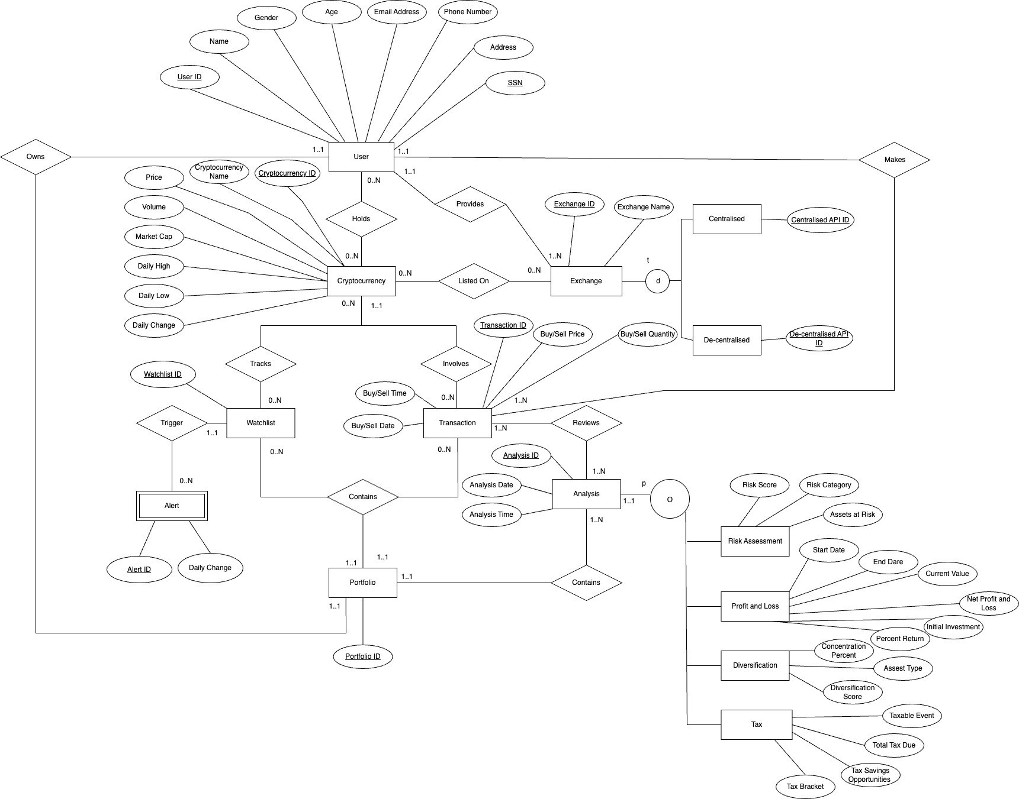
CONCEPTUAL MODEL : EER

Slide 5
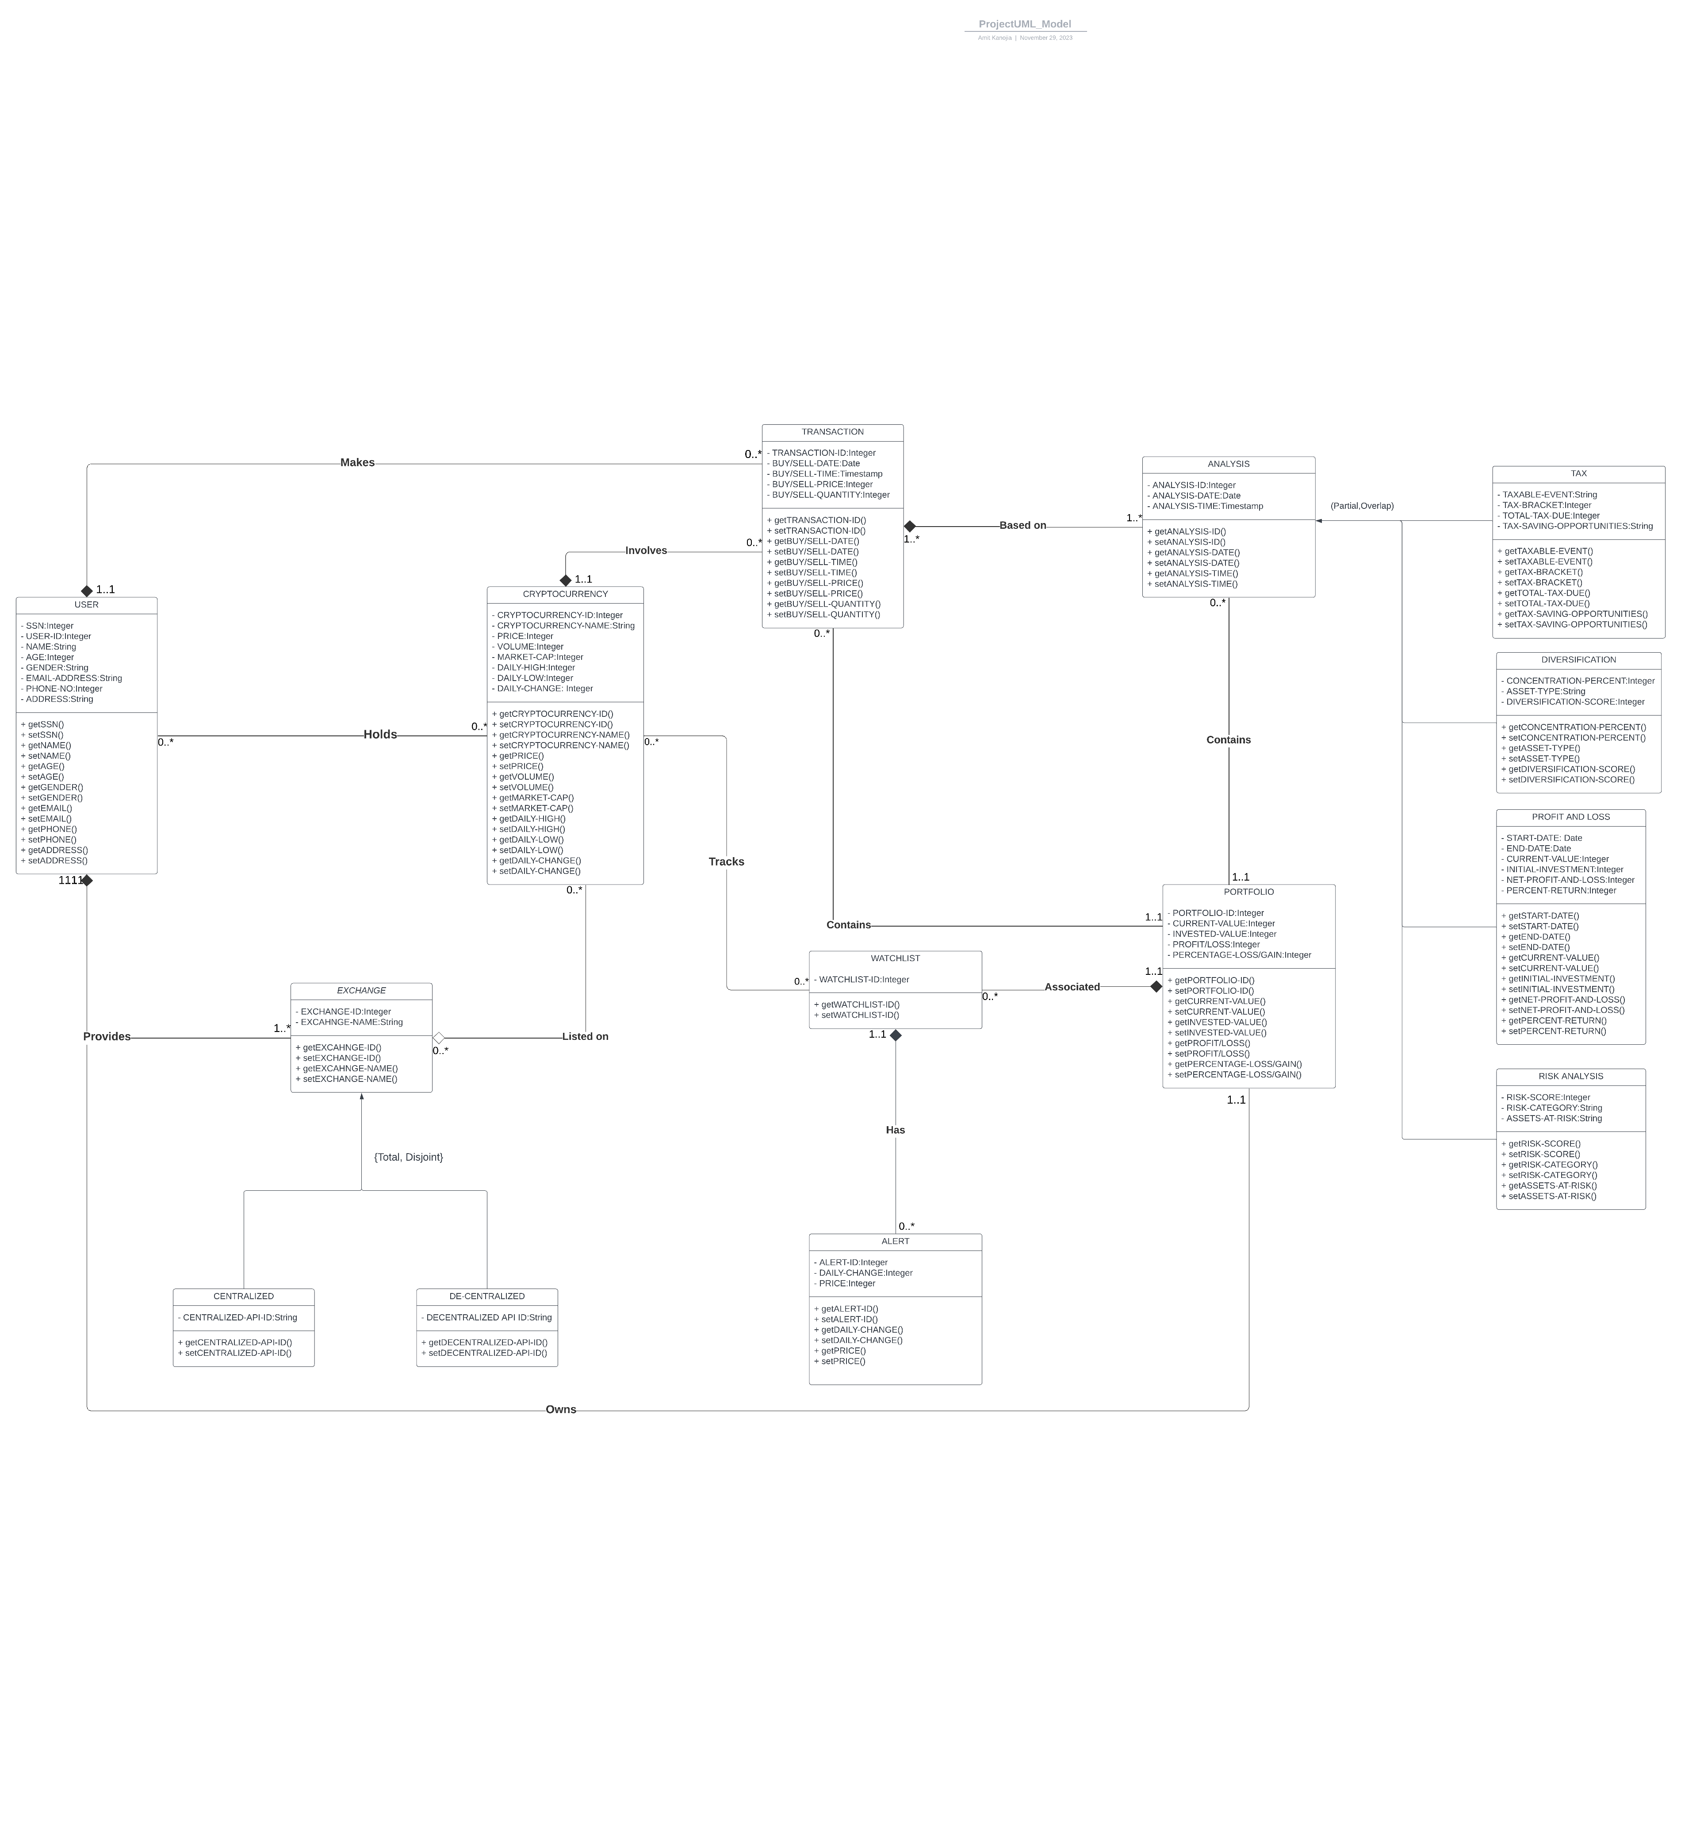
CONCEPTUAL MODEL : UML

Slide 6
RELATIONAL MODEL
User(User ID(PK),Name, Gender, Age, Email Address, Phone Number, Address, SSN(Unique))
User ID is primary key, NOT NULL
SSN is unique for user
Holds(User ID(FK),Cryptocurrency ID(FK))
User ID and Cryptocurrency ID form a composite primary key where User ID is a foreign key referring User ID in User table and Cryptocurrency ID is a foreign key referring Cryptocurrency ID in Cryptocurrency table
Cryptocurrency(Cryptocurrency ID(PK),Cryptocurrency Name, Price, Volume, Market Cap, Daily High, Daily Low, Daily Change)
Cryptocurrency ID is primary key, NOT NULL
Provides(User ID(FK),Exchange ID(FK))
User ID and Exchange ID form a composite primary key where User ID is a foreign key referring User ID in User table and Exchange ID is a foreign key referring Exchange ID in Exchange table
Tracks(Cryptocurrency ID(FK), Watchlist ID(FK))
Cryptocurrency ID and Watchlist ID form a composite primary key where Cryptocurrency ID is a foreign key referring Cryptocurrency ID in Cryptocurrency table and Watchlist ID is a foreign key referring Watchlist ID in Watchlist table
Listed_On(Cryptocurrency ID(FK),Exchange ID(FK))
Cryptocurrency ID and Exchange ID form a composite primary key where Cryptocurrency ID is a foreign key referring Cryptocurrency ID in Cryptocurrency table and Exchange ID is a foreign key referring Exchange ID in Exchange table

Slide 7
RELATIONAL MODEL
Exchange(Exchange ID(PK),Exchange Name, User ID(FK))
Exchange ID is primary key, NOT NULL
User ID is a foreign key referring to User ID in User table, NOT NULL
Centralized_Exchange(Exchange ID(PK), Centralized API ID)
Exchange ID acts as a foreign key referring to Exchange ID from Exchange Table
De-centralized_Exchange(Exchange ID(PK, De-centralized API ID))
Exchange ID acts as a foreign key referring to Exchange ID from Exchange Table
Watchlist(Watchlist ID(PK),Portfolio ID(FK))
Portfolio ID acts as a foreign key referring Portfolio ID in Portfolio table, NOT NULL
Transaction(Transaction ID(PK), Buy/Sell Price, Buy/Sell Quantity, Buy/Sell Date, Buy/Sell Time, User ID(FK), Portfolio ID(FK), Cryptocurrency ID(FK))
Portfolio ID and Cryptocurrency ID act as foreign key referring to Portfolio and Cryptocurrency tables, both columns are NOT NULL
Reviews(Transaction ID(FK),Analysis ID(FK))
Transaction ID and Analysis ID form a composite primary key where Transaction ID is a foreign key referring Transaction ID in Transaction table and Analysis ID is a foreign key referring Analysis ID in Analysis table

Slide 8
RELATIONAL MODEL
Portfolio(Portfolio ID(PK),User ID(FK))
Portfolio ID is primary key, NOT NULL
User ID acts as a foreign key referring to User ID in User table, NOT NULL
Alert(Alert ID(PK),Watchlist ID(FK),Daily Change)
Alert ID is primary key, NOT NULL
Watchlist ID acts as a foreign key referring to Watchlist ID in Watchlist table, NOT NULL
Analysis(Analysis ID(PK),Analysis Date, Analysis Time, Portfolio ID(FK))
Analysis ID is a primary key, NOT NULL
Portfolio ID acts as a foreign key referring to Portfolio ID in Portfolio table, NOT NULL
Risk Assessment(Risk Score, Risk Category, Assets at Risk, Analysis ID(FK))
Analysis ID acts as a foreign key referring Analysis ID in Analysis table
Profit and Loss(Start Date, End Date, Current Value, Net Profit and Loss, Initial Investment, Percent Return, Analysis ID(FK))
Analysis ID acts as a foreign key referring Analysis ID in Analysis table
Diversification(Concentration Percent, Asset Type, Diversification Score, Analysis ID(FK))
Analysis ID acts as a foreign key referring Analysis ID in Analysis table
Tax(Taxable Event, Total Tax Due, Tax Savings Opportunities, Tax Bracket, Analysis ID(FK))
Analysis ID acts as a foreign key referring Analysis ID in Analysis table

Slide 9
Cryptocurrencies represent a new era in finance, taking the form of digital money that's very secure, making it hard for anyone to make fake copies or spend the same money twice. Their growth has been remarkable, ballooning to a value of $1.4 trillion, which highlights their increasing acceptance in the global market.
Compared to traditional investments like stocks or property, cryptocurrencies can potentially bring in much bigger returns. But with these big rewards come significant risks that we should not ignore:
Data Security: Keeping these digital funds safe is crucial because the technology and platforms that hold them can be targets for theft.
High Volatility: The value of cryptocurrencies can change very quickly and unpredictably, which can be risky for investors.
Technical Complexity: Understanding how cryptocurrencies work can be difficult, as they involve complex technology.
Market Knowledge: Many people find the financial markets hard to understand, and the world of cryptocurrencies is even more challenging.
Our task is to navigate these issues, ensuring that people can invest in cryptocurrencies safely and with a clear understanding of what they're getting into."

Slide 10
First, we aim to create a secure database focused on cryptocurrency risk management—where security is not an afterthought but the foundation.
Next, we're looking at enabling real-time transaction handling. The cryptocurrency market never sleeps, and our systems must be robust enough to keep pace.
Furthermore, we'll be utilizing advanced analytics for risk evaluation, because data-driven decisions are the cornerstone of effective investment strategies.
Lastly, we strive to streamline operations across all crypto exchanges. The goal is to provide a unified, user-friendly interface that can handle the diverse and dynamic nature of cryptocurrency trading.
In essence, our project's mission is to mitigate the risks and enhance the safety of cryptocurrency trading for every investor across the spectrum. We're not just building a tool—we're aiming to cultivate a more informed and secure trading environment.

